Slide 1

Baymax
Casey Colins
Steven Dao
Maria Hernandez
Jordan Huff
Vineeth Konjeti
Amal Sam
Jonathan Tran
Your AI Medical Assistant

Slide 2




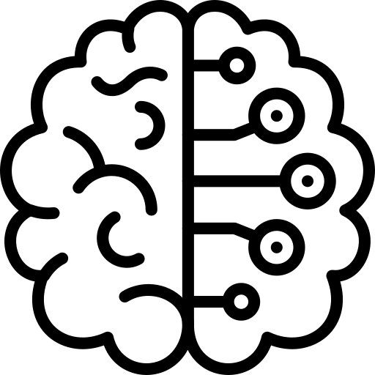
Overview
The Product
Healthcare Chatbot
Powered by A.I.
Referral to Professionals
User Friendly Design
General guidance on health and wellness
Integrated ChatGPT 4 responses
Location-based doctor referrals
Focus on ease of use and accessibility

Slide 3
Overview
The Purpose
Navigating Complex Medical Information – Too much complex data for the average person to understand
Initial Health Consultation Hesitancy – People are hesitant to ask for help
Personalized Health Information Search – Challenges in finding specific information relevant to personal health needs

Slide 4
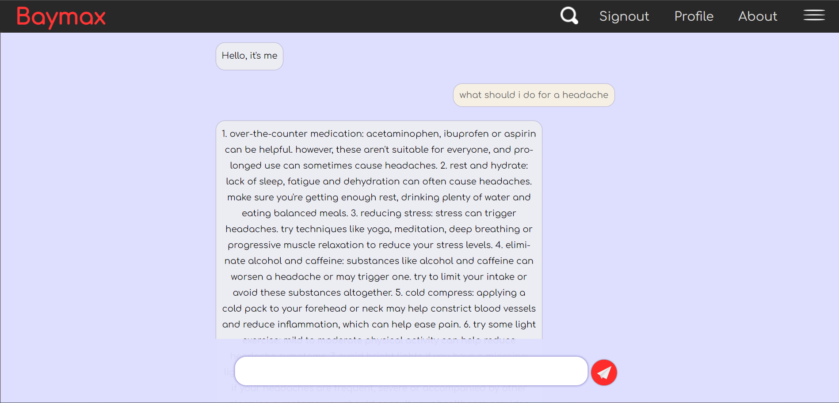
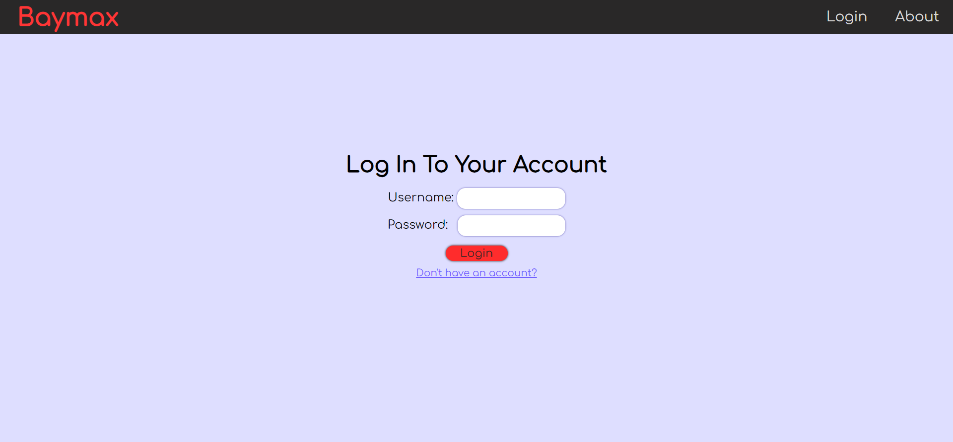
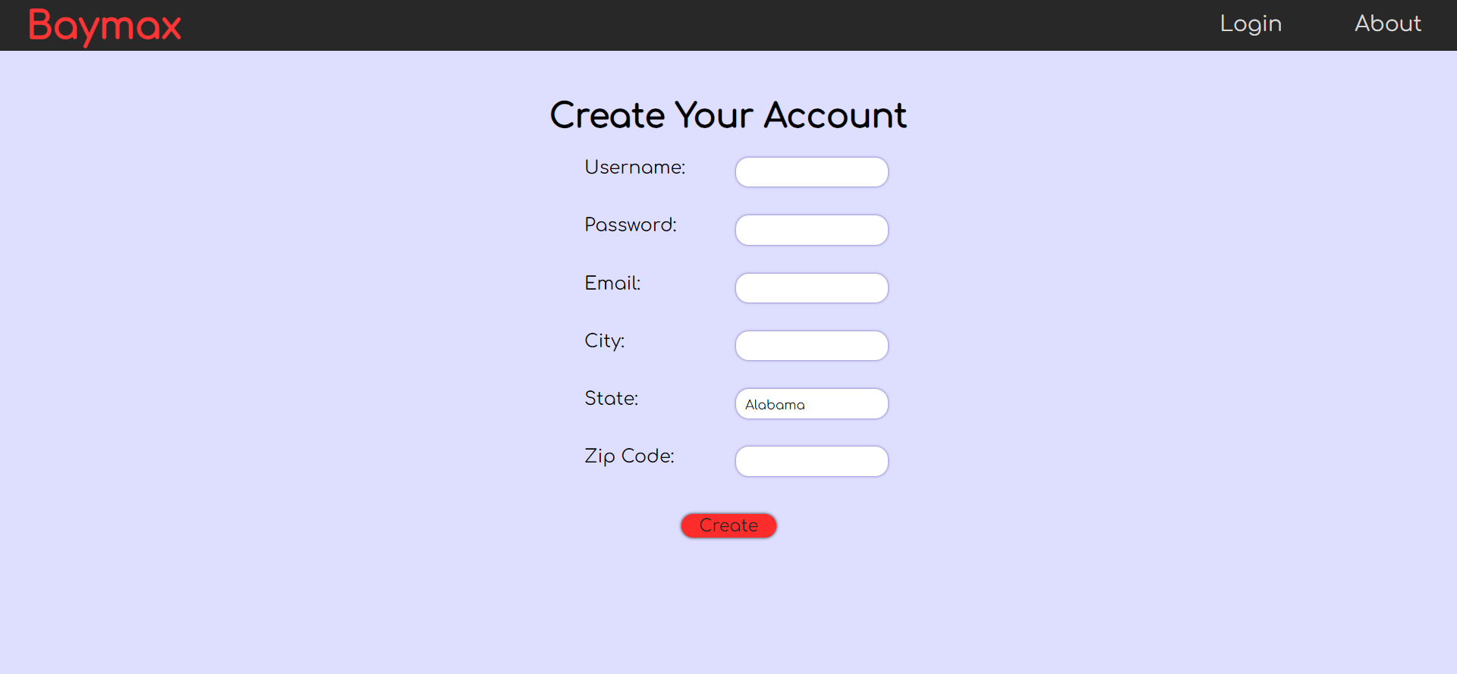
Front-End
Page Layout
Chat Page
Communicate with the AI
Only accessible with an account
Log In
Log in to your account
Has access to account creation page
Create Account
Users input username and password
Includes basic information (email, city, etc.)

Slide 5
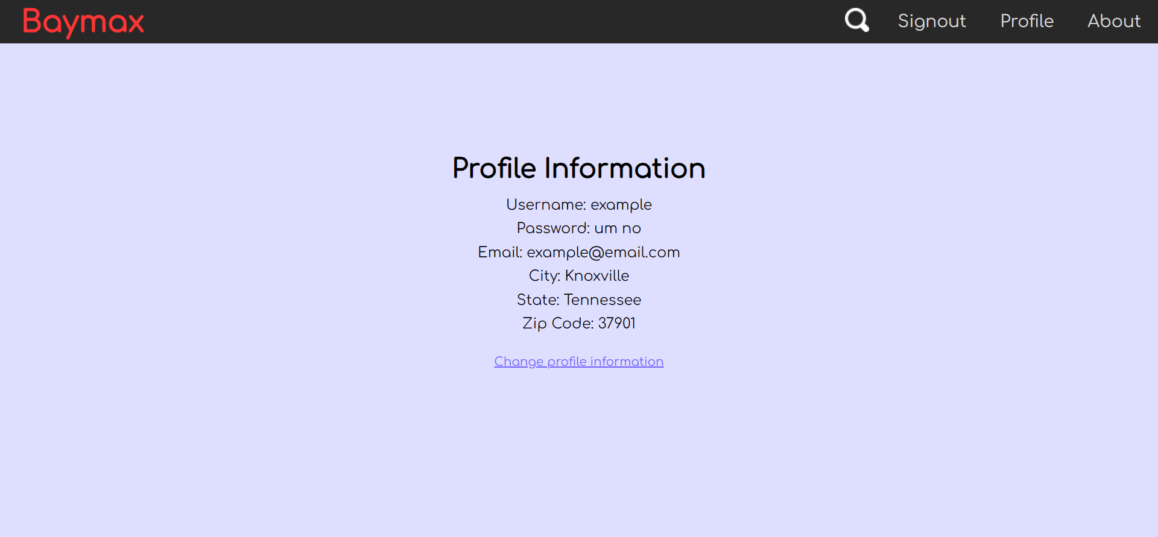
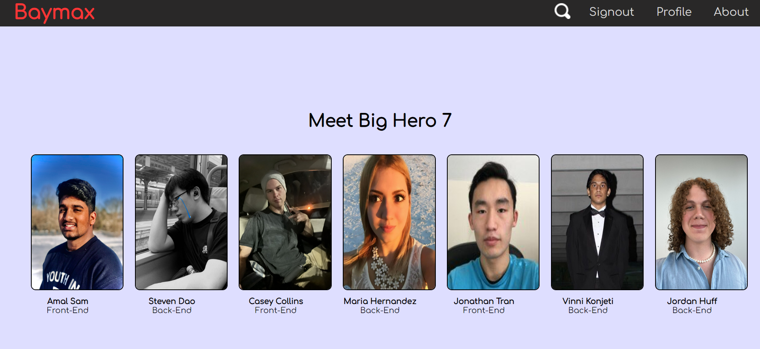
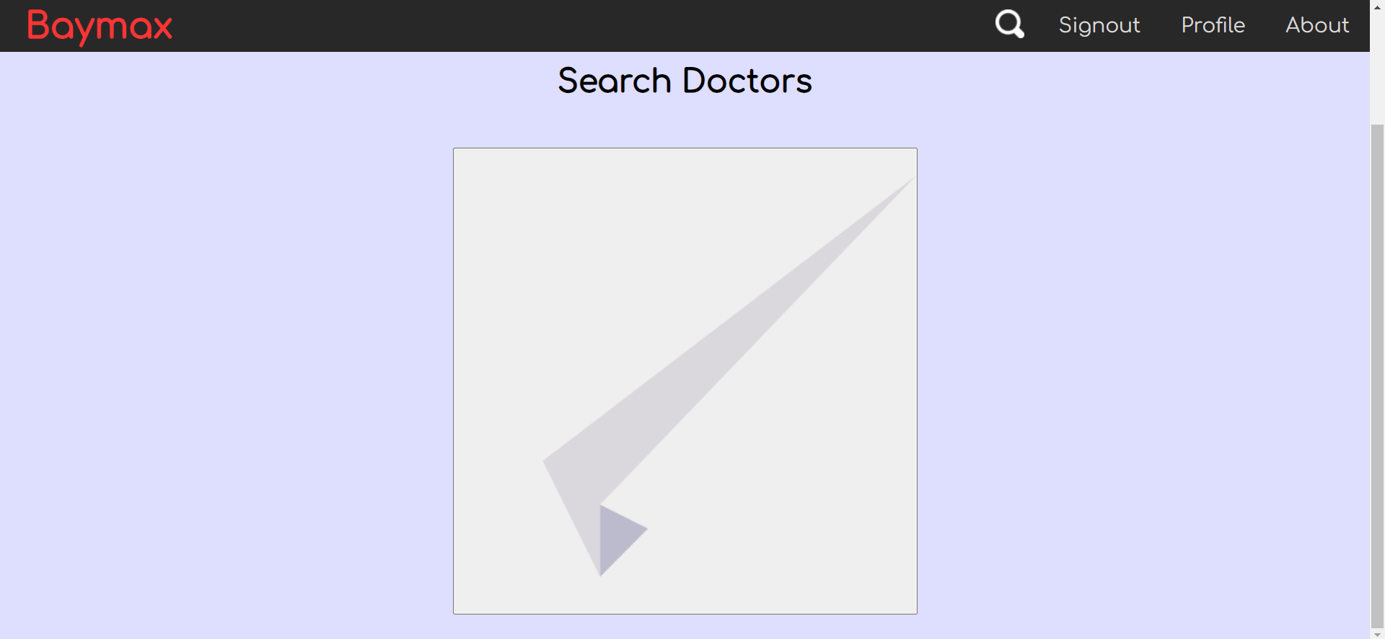
Front-End
Page Layout (cont.)
Profile
View your profile information
Can change your profile information
About
Illustrates all members of the project and their general role
Search
In progress...
Allows users to search for doctors directly

Slide 6

Application Architecture
Django
Nginx
Docker
Virtual Docker Network
Docker Container
Docker Container
Web
Server
Application Server
Nginx
Django
Static Files
SQL Lite
Notes:
Django is the application server and authentication server
Holds authentication data and user region data
Docker to standardize environments

Slide 7
Application Server
Dynamic Page Generation
Host API Endpoints
Database Interface
Response Generation
Handle User Authentication
Notes:
Originally, API Endpoints and Dyanamic Page Generation were going to be done on two different servers connected to the same url via Nginx, but due to time constraints. But it made more sense to go with a more monolithic architecture given the time constraints.
Dynamic page generation using Django’s built in templating system’
Session authentication
Token authentication

Slide 8
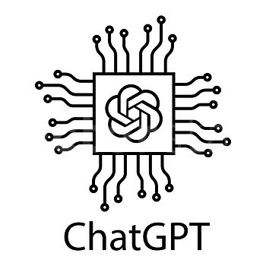

Machine Learning
Core Features
Prompt-Response Pipeline
ANN Input Classification
Integration of ChatGPT 4
Input user prompt
Output medical response
Search response for keywords
Directs users to specialists when keyword isn’t found
Input user prompt
Output medical taxonomy code

Slide 9
Machine Learning
Core Features
Prompt-Response Pipeline
ANN Input Classification
Integration of ChatGPT 4
Input user prompt
Output medical response
Search response for keywords
Directs users to specialists when keyword isn’t found
Input user prompt
Output medical taxonomy code

Slide 10


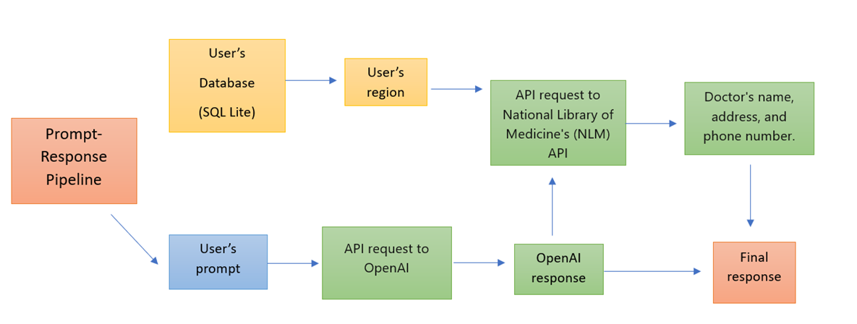
Machine Learning
Prompt-Response Pipeline

Slide 11
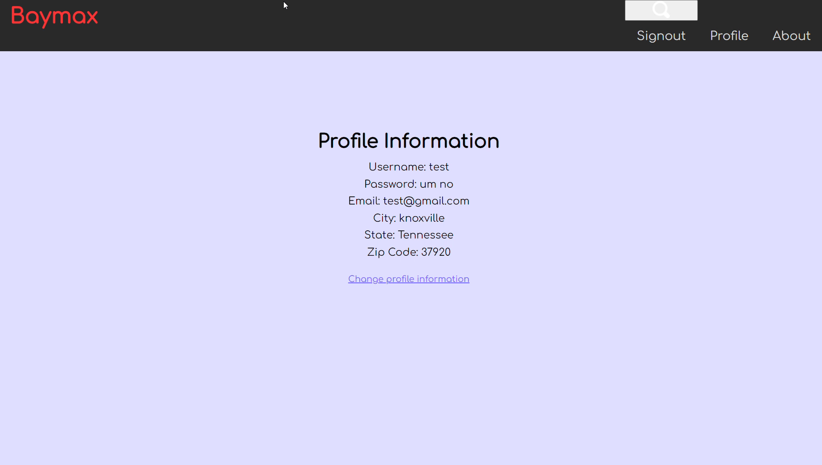
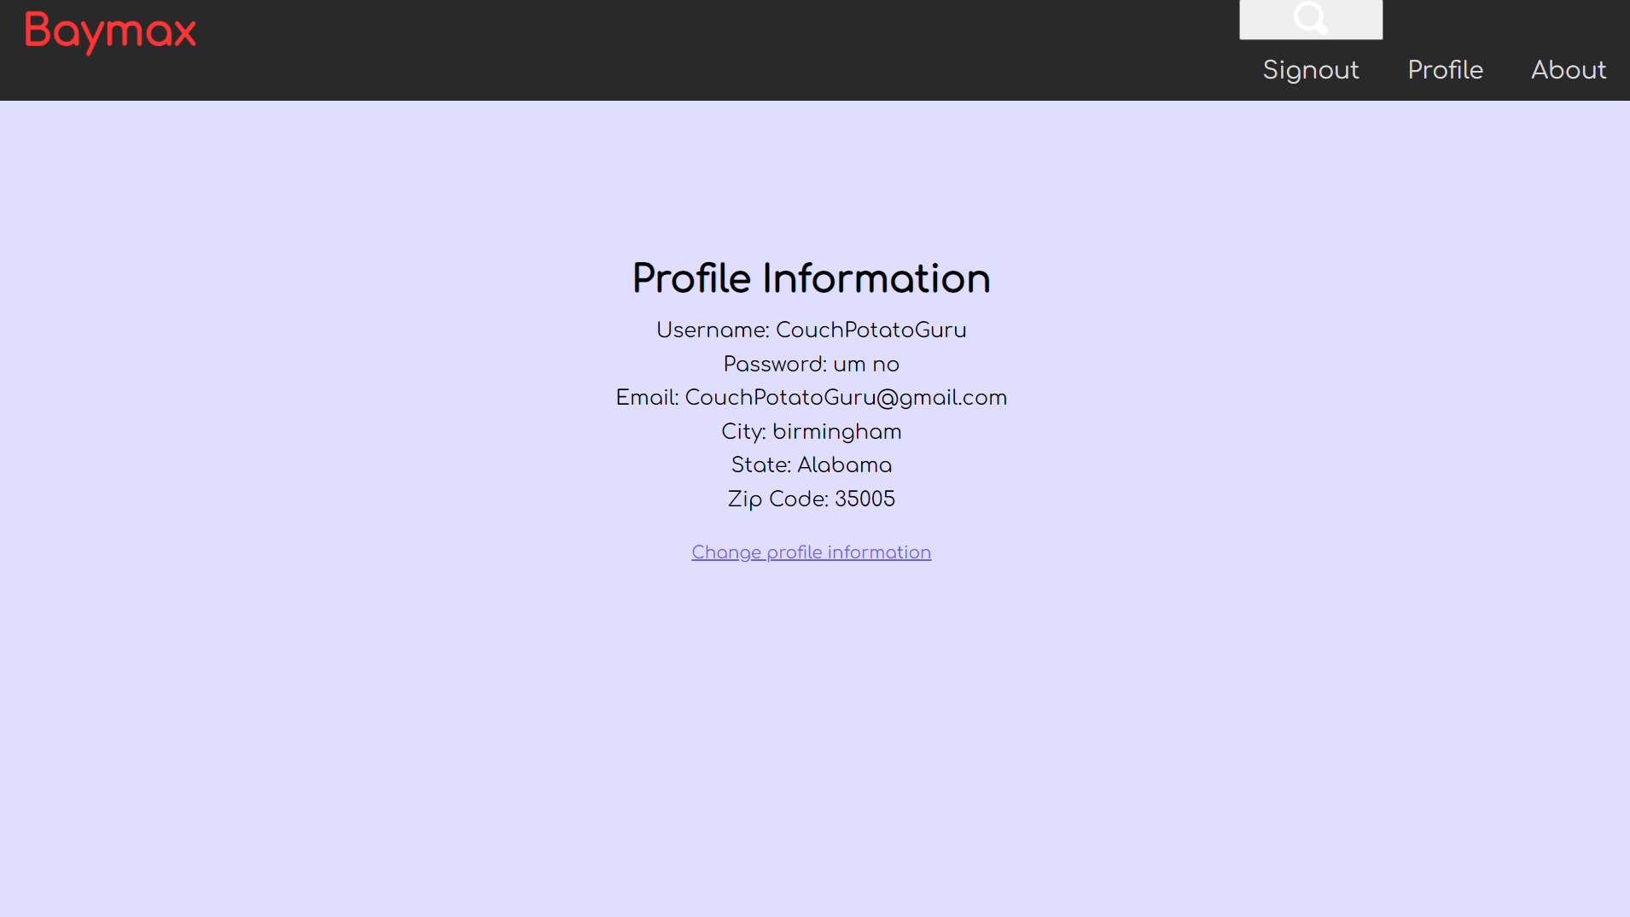
Examples
User from Knoxville
User from Birmingham

Slide 12
Machine Learning
Core Features
Prompt-Response Pipeline
ANN Input Classification
Integration of ChatGPT 4
Input user prompt
Output medical response
Search response for keywords
Directs users to specialists when keyword isn’t found
Input user prompt
Output medical taxonomy code

Slide 13
Machine Learning
Text Classification
Yes
Doctor Database
Local Doctors
User
Is Keyword Found?
Keyword Search
Classification
Artificial Neural Network (ANN)
No

Slide 14
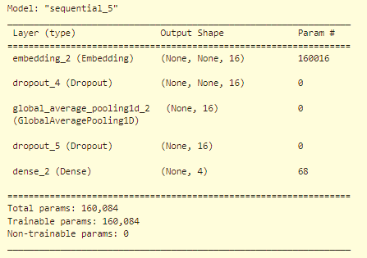
Machine Learning
Text Classification
Machine Learning Model
Artificial Neural Network (ANN)
Multi-class classification
Supervised Data
ChatGPT-generated medical questions
~2000 prompts for testing and training
Results
95.3% accuracy for 4 classes

Slide 15
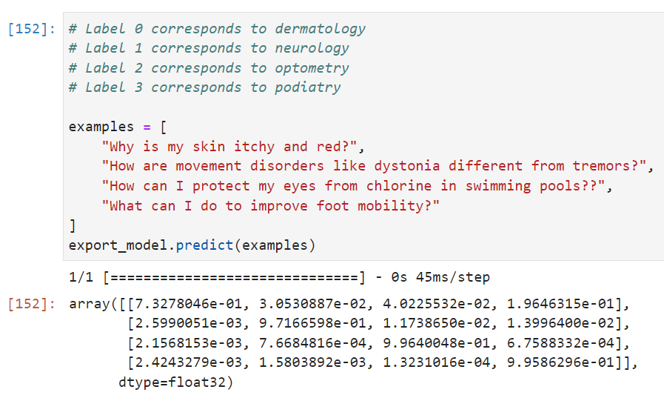
Machine Learning
Text Classification
 |  | Input Prompts
 |  | Q1 | Q2 | Q3 | Q4
Model Prediction | Dermatology | 73.3% | 0.3% | 0.2% | 0.2%
 | Neurology | 3.1% | 97.2% | 0.1% | 0.2%
 | Optometry | 4.0% | 1.2% | 99.6% | 0.0%
 | Podiatry | 19.6% | 1.4% | 0.1% | 99.6%

Slide 16
Challenges
Working with HTTP (API Requests)
Session-based Authentication Protocol over HTTP
Mid-semester Architecture Changes
Loss of NHS-LLM Model
Notes:
Django’s session auth required cross forgery resource protection
Mid semester architecture changes caused by reevaluation of time and scope creep

Slide 17
Baymax
Questions?
Your Personal Healthcare Assistant

Slide 18
Overview
AI-Based Health Assistant:
A specialized version of ChatGPT focused on providing health-related information
General Health Advice:
Capable of offering general guidance on health and wellness topics (not a substitute for professional medical care)
Referral to Medical Professionals:
Ability to direct users to appropriate healthcare providers based on the user's region
Accessible and User-Friendly:
Designed to be easy to use, providing clear and understandable health information

Slide 19
Machine Learning
LLM Integration
ChatGPT
Doctors Database
Prompt
Response
Keywords
User
Location
Doctor Search
List of Doctors

Slide 20
Front-End
Page Layout
Specific pages
Buttons
User accessibility
How we made it look pretty
CSS

